Slide 1
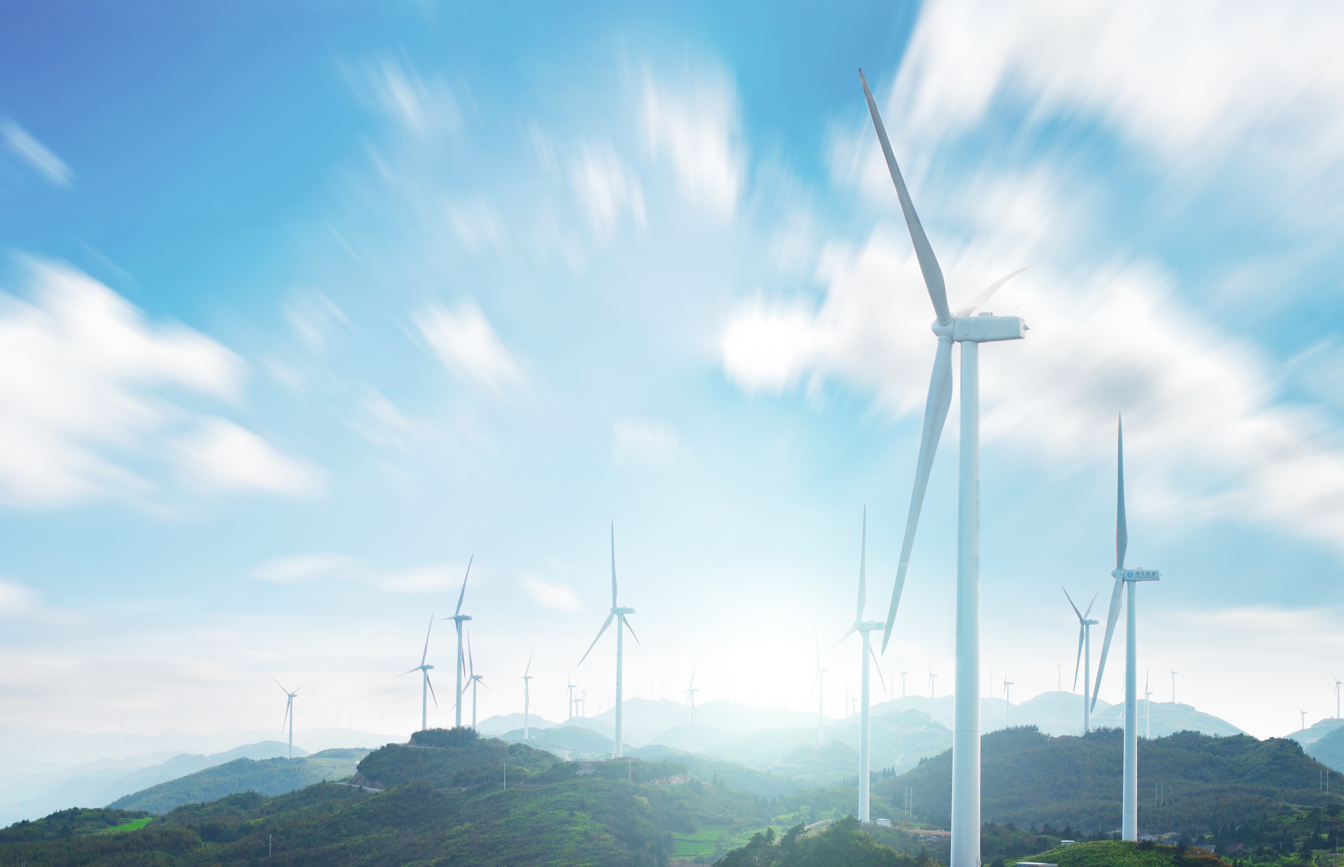


Climate Change Impacts on Power Infrastructure
Pierre-Olivier Pineau
Professor, Chair in Energy Sector Management
HEC Montréal, Canada
Session 2b 22/September/2026

Slide 2
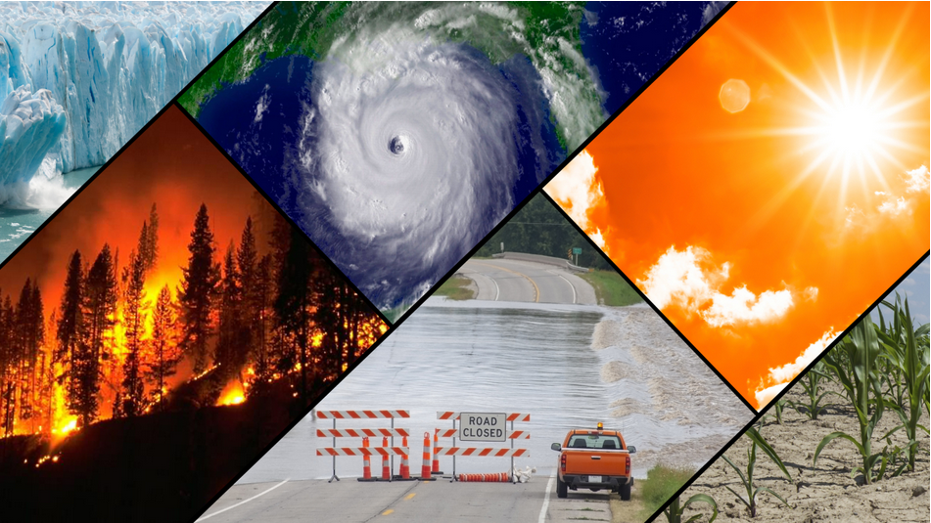
Events Related to Climate and Weather: Glacial Ice, Wildfires, Hurricanes, Floods, and Drought
NOAA (2025)
Notes:
A collage of events related to climate and weather: loss of glacial ice, wildfires, hurricanes, floods, and drought. (Image credit: NOAA)
Climate change impacts
NOAA/National Oceanic and Atmospheric Administration
https://www.noaa.gov/education/resource-collections/climate/climate-change-impacts

Slide 3
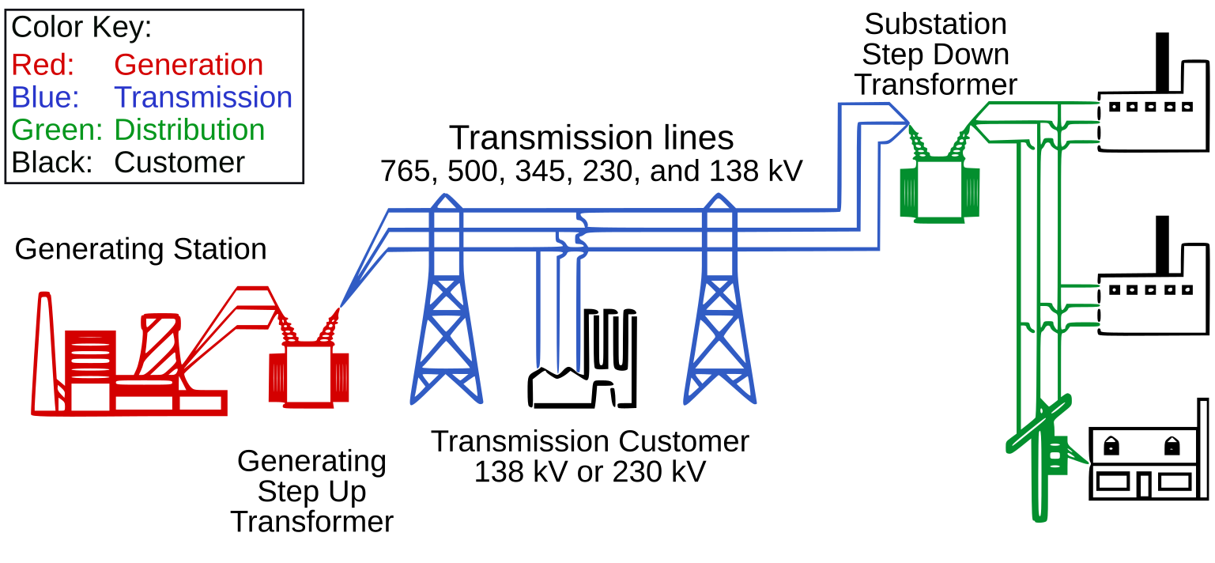
Impacts on Power Infrastructure
Capacity losses with higher temperature
Vegetation management
Degradation of electricity wooden poles
Wildfires
Cooling water
temperature rise
US DoE (2004)
Notes:
By United States Department of Energy, SVG version by User:J JMesserly - Final Report on the August 14, 2003 Blackout in the United States and Canada. ferc.gov 13. Federal Energy Regulatory Commission (April 2004). Retrieved on 2010-12-25., Public Domain, https://commons.wikimedia.org/w/index.php?curid=5577847

Slide 4
Regulatory Responses
Anticipate future costs => Invest in adaptation
Reduce exposure => Invest in energy efficiency
Mitigate GHG emissions => Limit future global warming
Do nothing => Increase future risks, power failures & costs

Slide 5
Climate Change Impacts on Power Infrastructure
Session 2b - Network reliability in a world of increasing climate change

